Slide 1
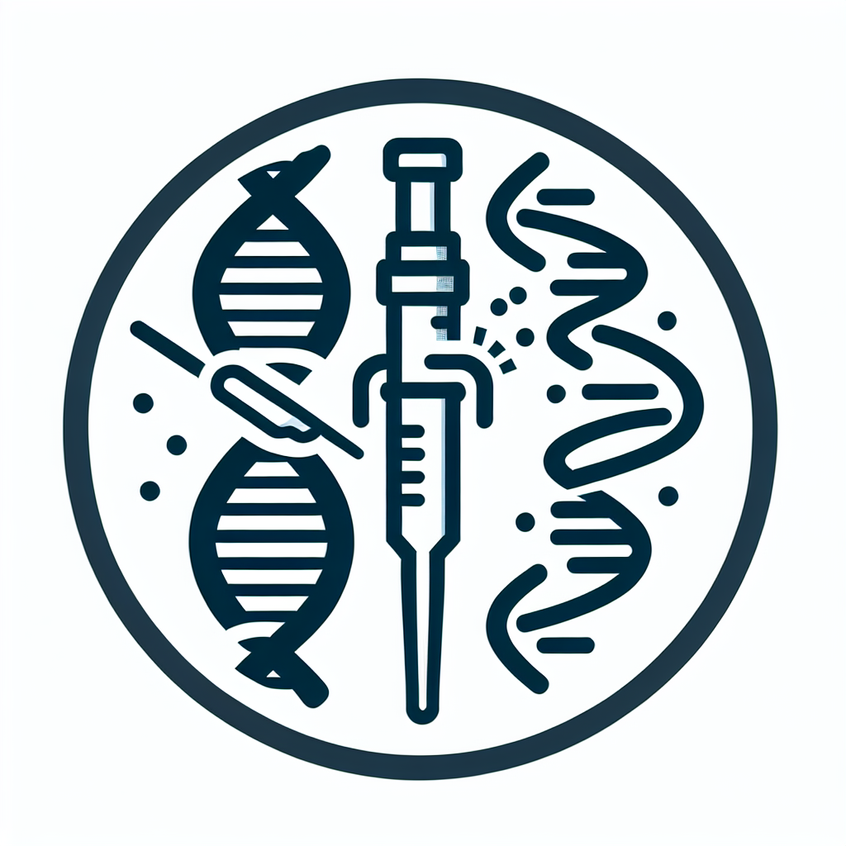
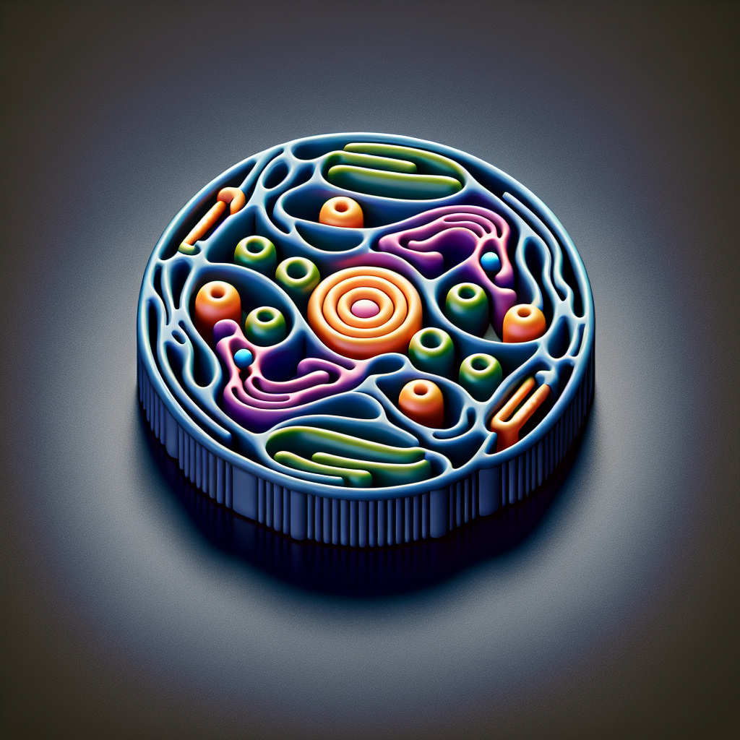
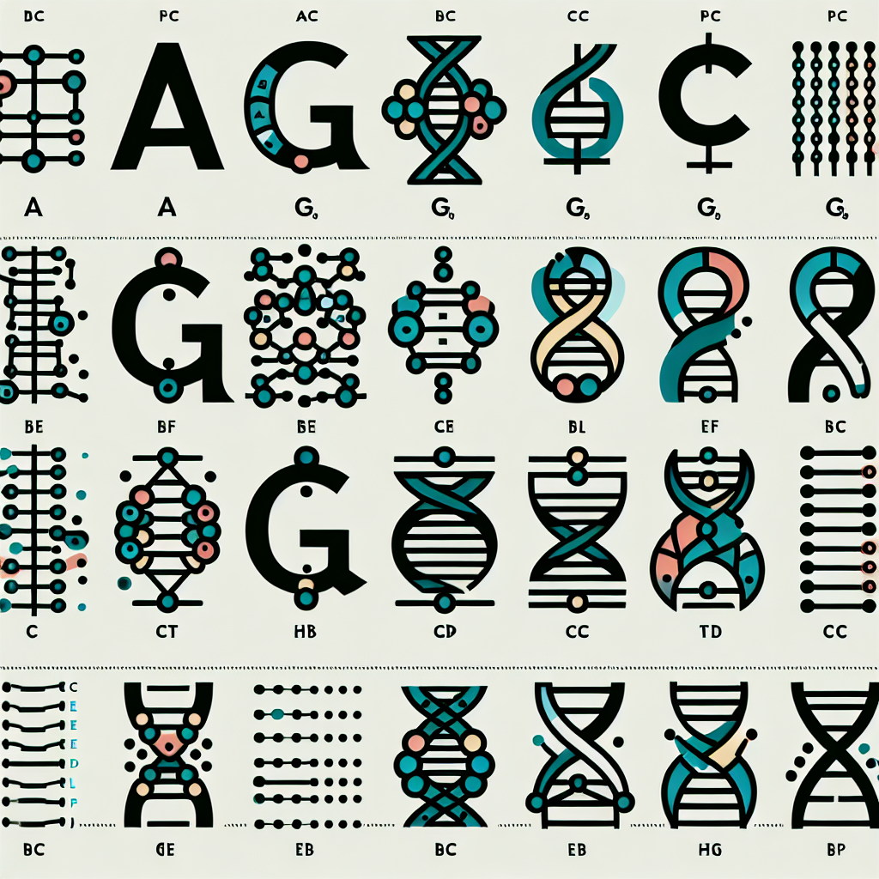


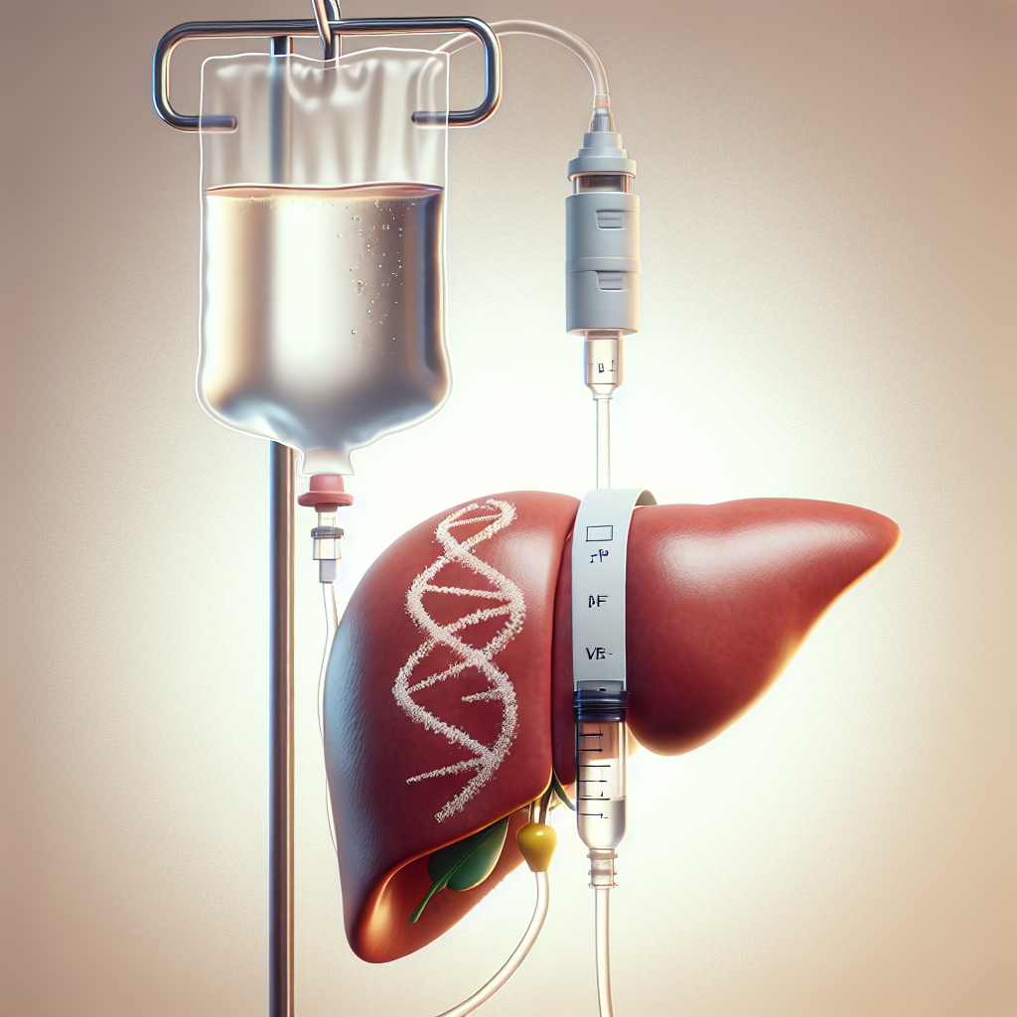


Breakthroughs Timeline
2012 — Programmable CRISPR‑Cas9 editing
Proof point: In vitro demonstration of RNA‑guided DNA cleavage (Jinek et al., Science)
2013 — Editing in mammalian cells
Proof point: CRISPR‑Cas9 enables targeted gene disruption and HDR in human cells
2016 — Base editing introduced
Proof point: Cytosine and adenine base editors expand precise, DSB‑free editing
2019 — Prime editing unveiled
Proof point: Versatile small insertions/deletions/substitutions without donor DNA
2020 — Nobel Prize in Chemistry
Proof point: Recognition of Doudna and Charpentier for CRISPR‑Cas9
2021 — First in vivo CRISPR infusion shows strong target knockdown
Proof point: ATTR program demonstrates dose‑dependent TTR reduction after a single IV dose
2022 — First in‑human base editing data
Proof point: In vivo base editing of PCSK9 shows sustained LDL‑C lowering
2023–24 — First regulatory approvals of a CRISPR therapy
Proof point: Exagamglogene autotemcel (exa‑cel/CASGEVY) approved for severe SCD; broader indications and regions follow

